Slide 1
Referencing Schemes

Slide 2
Options
External reference
Device reference

Slide 3
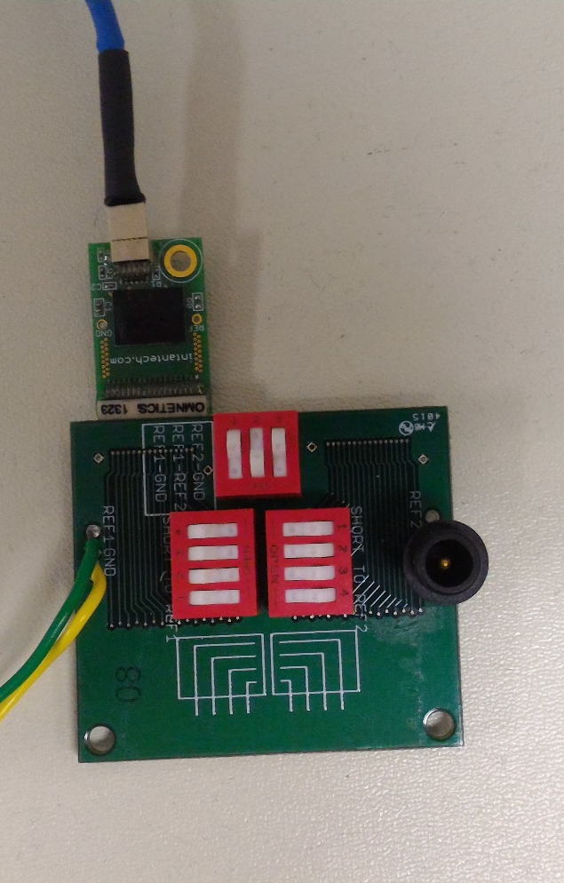
External reference
Connect a needle probes to Ref1 or Ref2
Orange circles indicate the down position of the switches
The configuration makes it so that none of the depth electrodes are connected to reference
Front Side
Intan Amplifier
64 chan
Switches
Ref and Gnd Connections

Slide 4
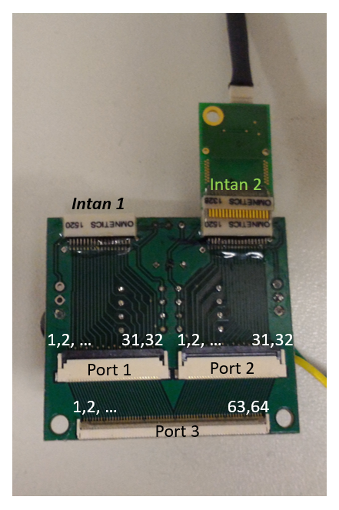
Depth Channel Reference
Front Side
Back Side
Ensure that the macro electrode are connected to the inner ribbon channels are indicated by the arrows
Positions the switches are according to the orange dots
Intan Amplifier
64 chan
Switches
Ref and Gnd Connections
Macro electrode

